Slide 1
Axiomatic Attribution for deep networks
Mukund Sundararajan, Ankur Taly, Qiqi Yan
Attributing the prediction of a deep network to its input features (a problem previously studied by several other works)

Slide 2
Abstract -- attributing the prediction of a deep network to its input features
﻿They identify two fundamental axioms: Sensitivity + Implementation Invariance
They show that the two not satisfied by most known attribution methods (a fundamental weakness of those methods).
Integrated Gradients -- a new attribution method:
requires no modification to the original network
Extremely simple to implement
apply this method to a couple of image models, a couple of text models and a chemistry model

Slide 3
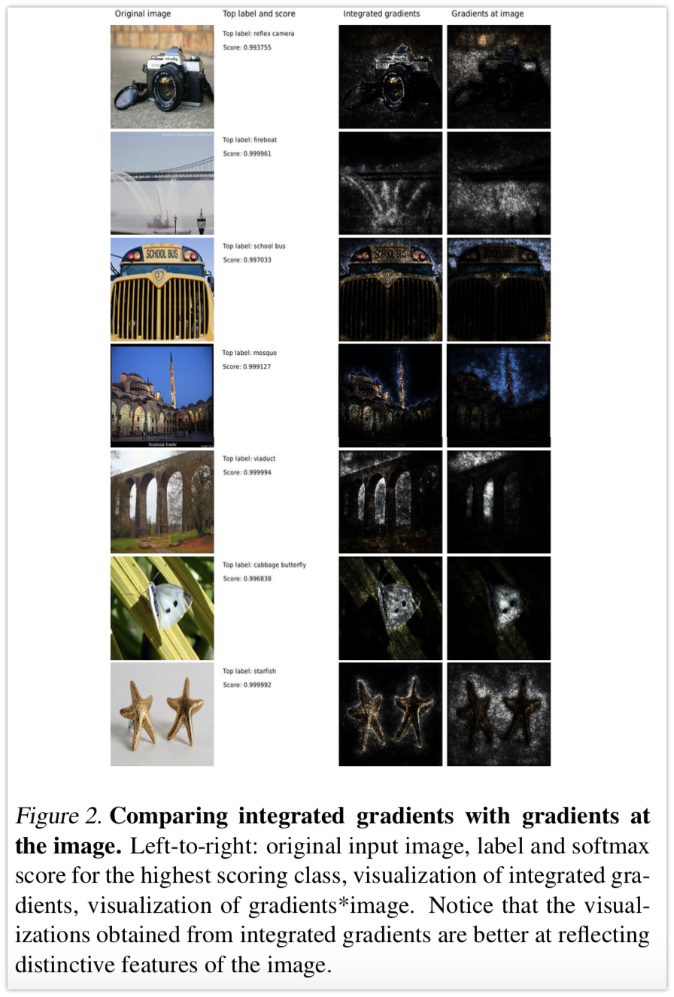
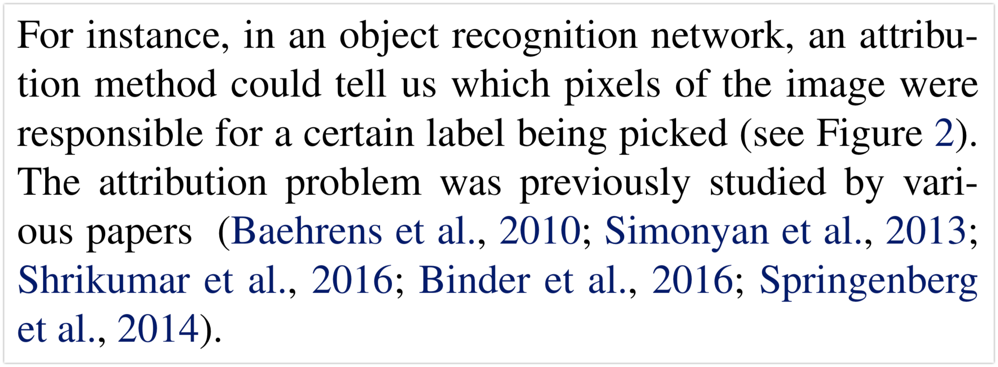
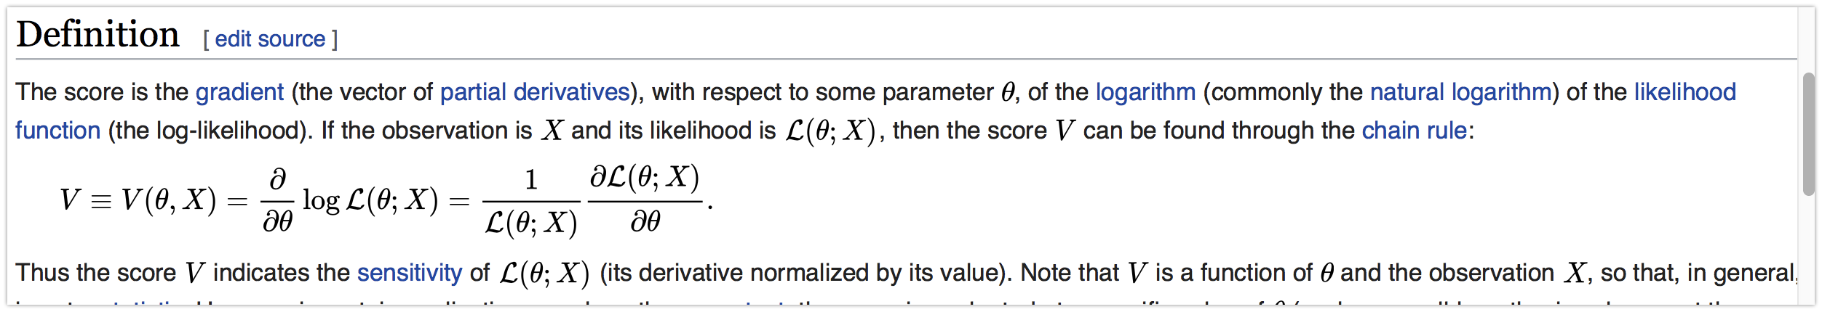
Instance for (definition 1?) attribution method
Scores (in figure 2) is talking about sensitivity ? w.r.t. parameters according to https://en.wikipedia.org/wiki/Score_(statistics)#Definition

Slide 4
More words for attribution method
﻿The intention of these works is to understand the input-output behavior of the deep network, which gives us the ability to improve it. Such understandability is critical to all computer programs, including machine learning models. There are also other applications of attribution. They could be used within a product driven by machine learning to provide a rationale for the recommendation.
For instance, a deep network that predicts a condition based on imaging could help inform the doctor of the part of the image that resulted in the recommendation. This could help the doctor understand the strengths and weaknesses of a model and compensate for it. We give such an example in Section 6.2. Attributions could also be used by developers in an exploratory sense.
For instance, we could use a deep network to extract insights that could be then used in a rule-based system. In Section6.3, we give such an example.

Slide 5
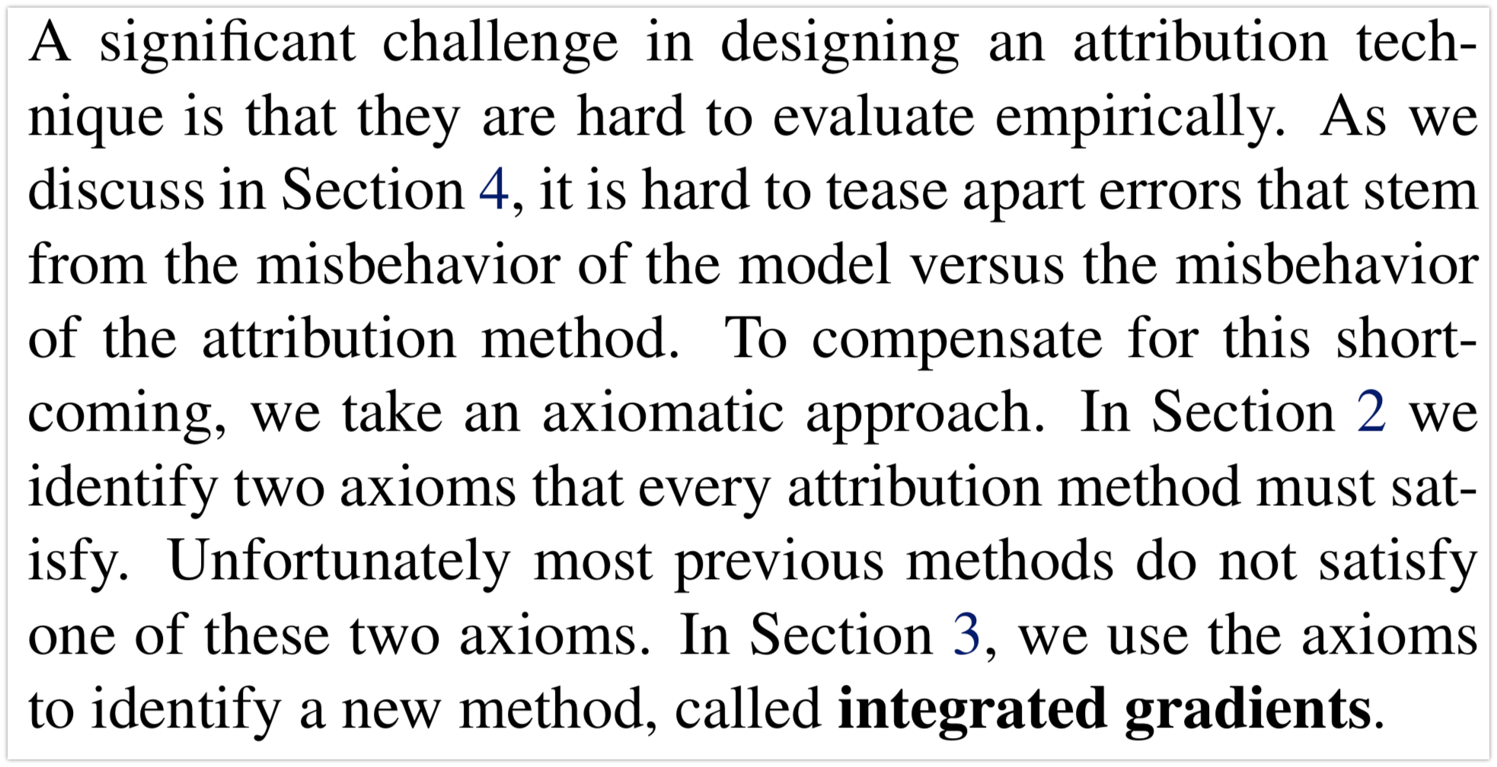
A significant challenge in designing an attribution technique

Slide 6
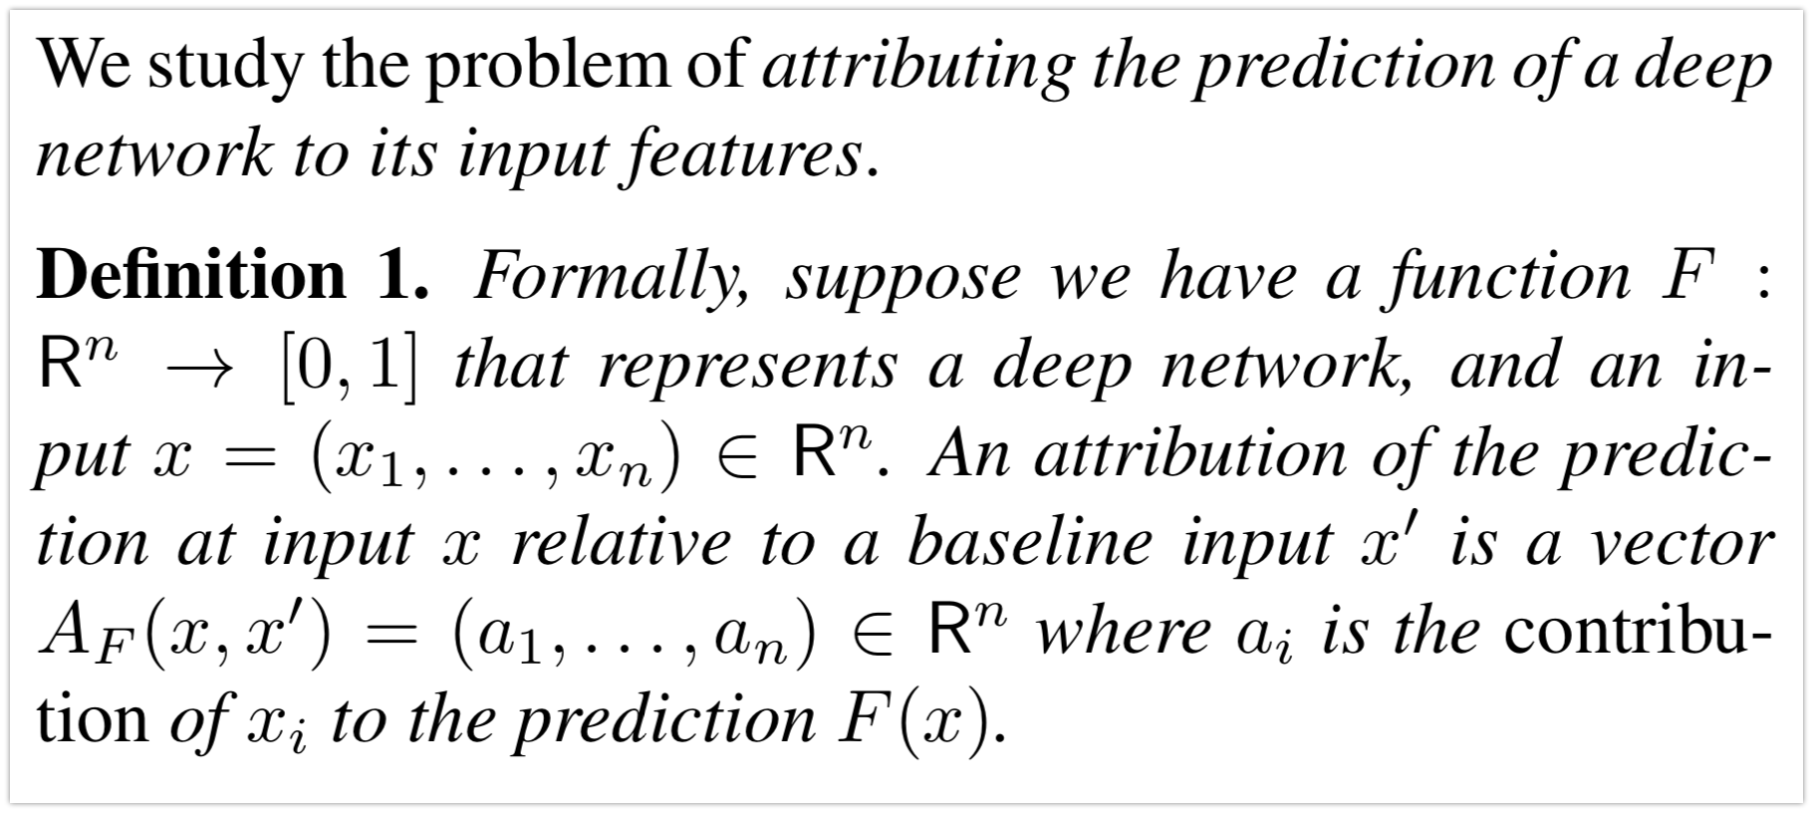
Before two axioms definition 1
Probability for certain label
Axioms will mention concept like “baseline”

Slide 7
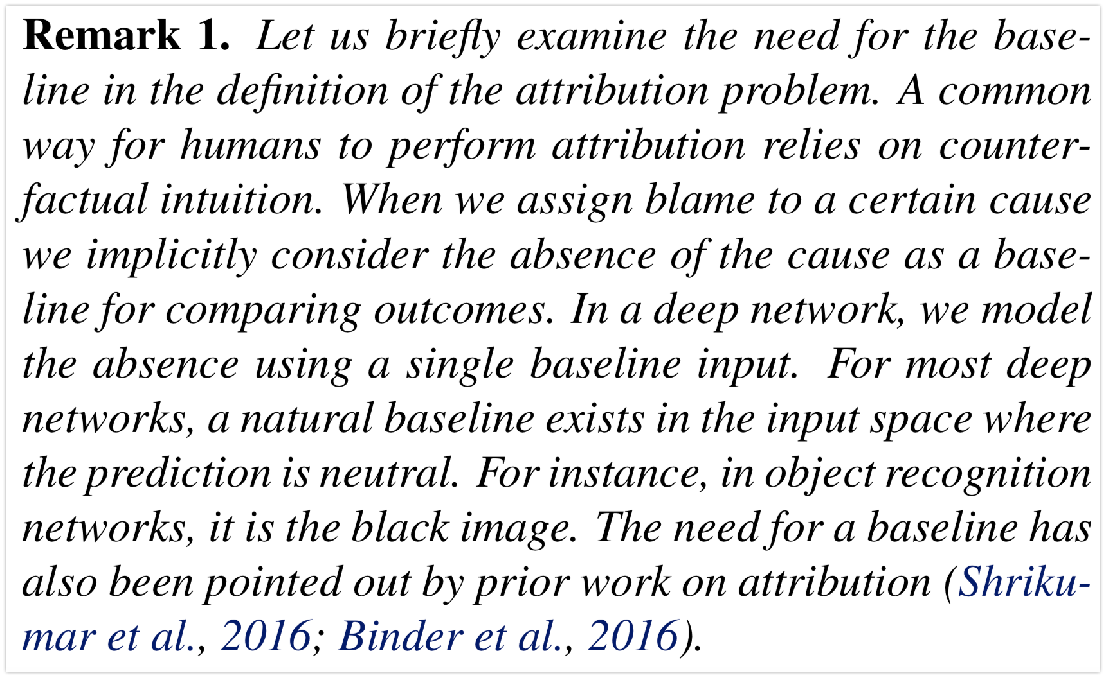
The need for the baseline in definition 1
Control group
&
Experimental/ treatment group

Slide 8
Two fundmental axioms -- axiom 1 sensitivity
sensitivity (a) if for every input and baseline that differ in one feature but have different predictions then the differing feature should be given a non-zero attribution.
sensitivity (b) If the function implemented by the deep network does not depend (mathematically) on some variable, then the attribution to that variable is always zero.

Slide 9
Gradients violates sensitivity (a)
Gradients: For linear models, ML practitioners regularly inspect the products of the model coefficients? and the feature values in order to debug predictions. Gradients (of the output with respect to the input) is a natural analog of the model coefficients for a deep network, and therefore the product of the gradient and feature values is a reasonable starting point for an attribution method (Baehrens et al., 2010; Simonyan et al., 2013); see the third column of Figure 2 for examples. The problem with gradients is that they break sensitivity, a property that all attribution methods should satisfy.

Slide 10
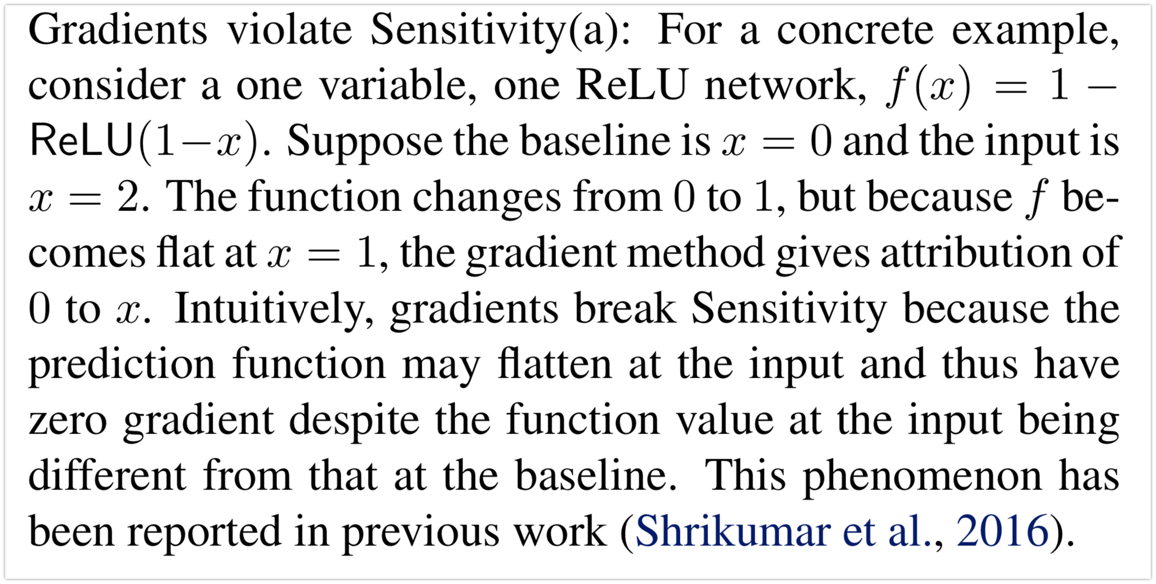
Gradients violates sensitivity (a)
Maybe just HEURISTC: for example, you can analyze this case in a different way (since you are talking about baseline here): why not compare two gradients? – then you can see differences!!
the paper Hengchu had not finished discussing.

Slide 11
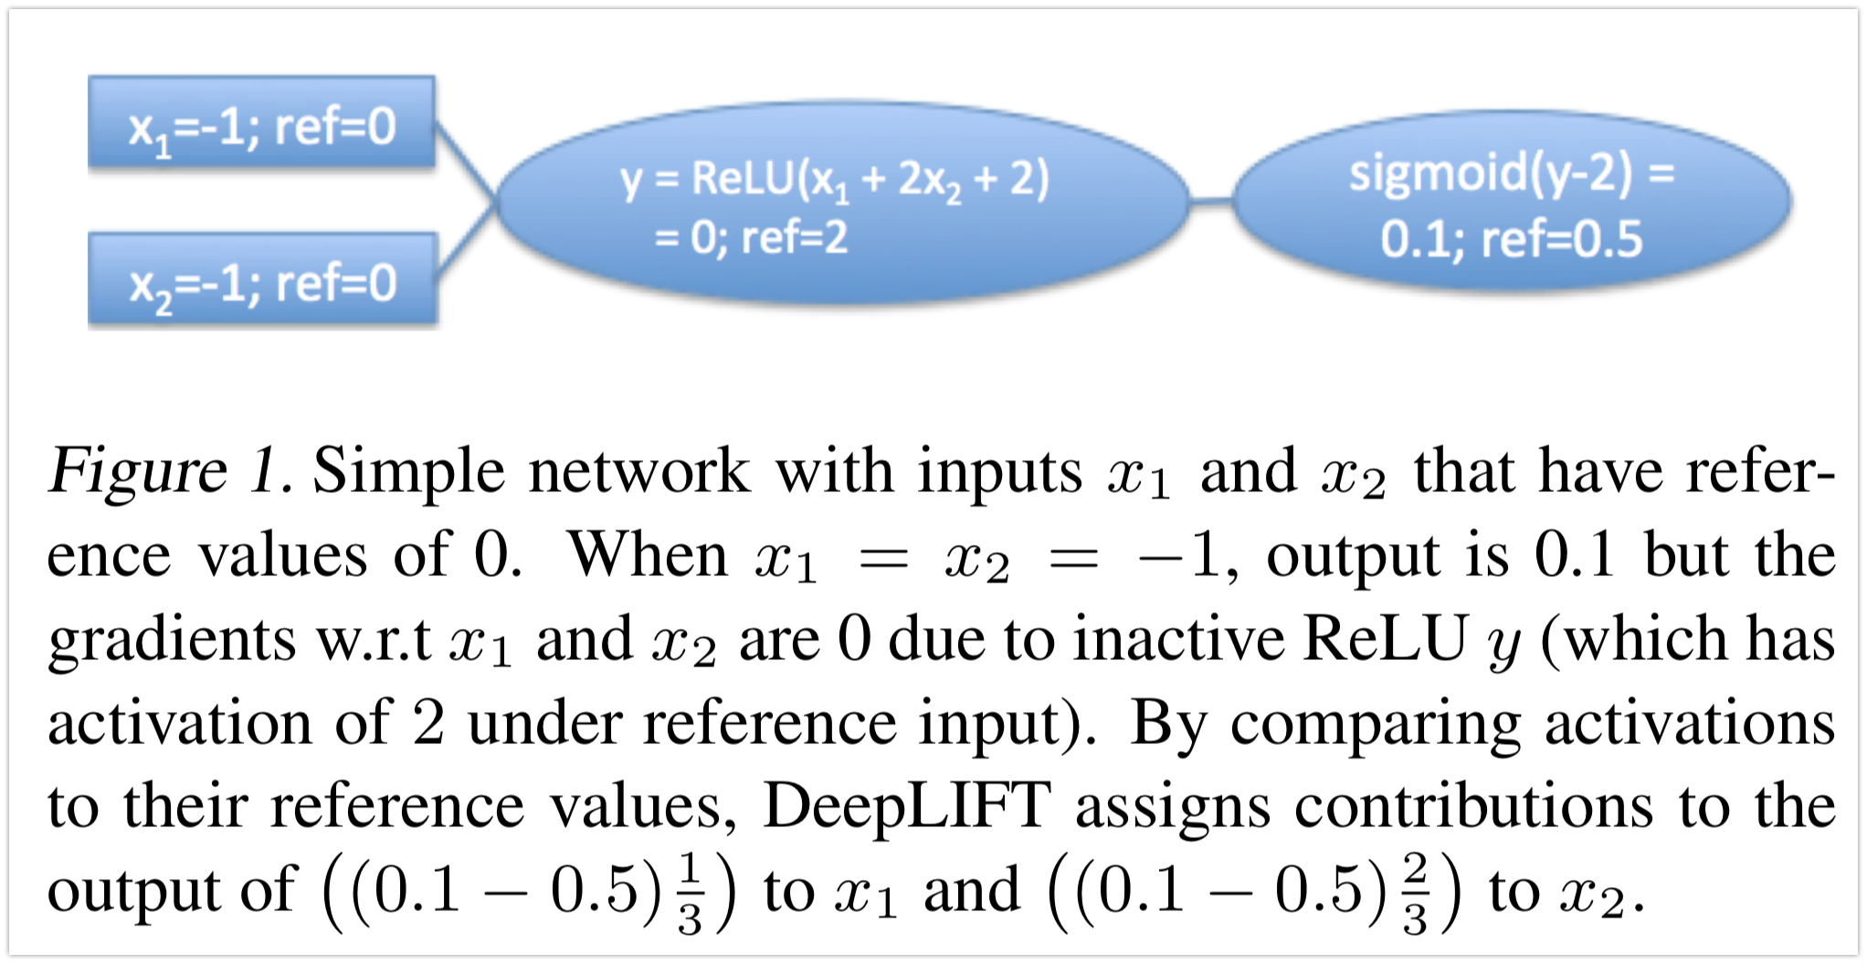
Gradients violates sensitivity (a)
“Gradient-based approaches are problematic because activation functions such as ReLUs have a gradient of zero when they are not firing, and yet a ReLU that does not fire can still carry information (Figure 1). Similarly, sigmoid or tanh activations are popular choices for the activation functions of gates …”
Shrikumar, Avanti, et al. "Not just a black box: Learning important features through propagating activation differences." arXiv preprint arXiv:1605.01713 (2016).
Two small questions: what is “firing”, what are “reference input, reference value” for neural activations?

Slide 12
Gradients violates sensitivity (a)
Practically, the lack of sensitivity causes gradients to focus on irrelevant features (see the “fireboat” example in Figure 2).

Slide 13
Deconvolution networks (DeConvNets), and Guided back-propagation violate Sensitivity(a)
﻿﻿Other back-propagation based approaches: A second set of approaches involve back-propagating the final prediction score through each layer of the network down to the individual features. These include DeepLift (Hengchu’s again), Layer-wise relevance propagation (LRP), Deconvolutional networks (DeConvNets), and Guided back-propagation. These methods differ in the specific backpropagation logic for various activation functions (e.g., ReLU, MaxPool, etc.). How different?

Slide 14
Deconvolution networks (DeConvNets), and Guided back-propagation violate Sensitivity(a)
﻿Unfortunately, Deconvolution networks (DeConvNets), and Guided back-propagation violate Sensitivity(a). This is because these methods back-propogate through a ReLU node only if the ReLU is turned on at the input. This makes the method similar to gradients, in that, the attribution is zero for features with zero gradient at the input despite a non-zero gradient at the baseline. We defer the specific counterexamples to Appendix B. How different? At this step, the essential is the same to me.

Slide 15
DeepLift & LRP violate a different requirement on attribution methods
﻿Methods like DeepLift and LRP tackle the Se﻿nsitivity issue by employing a baseline, and in some sense try to compute ``discrete gradients‘’ instead of (instantaeneous) gradients at the input. (The two methods differ in the specifics of how they compute the discrete gradient). But the idea is that a large, discrete step will avoid flat regions, avoiding a breakage of sensitivity. Unfortunately, these methods violate a different requirement on attribution methods. What is “a different requirement on attribution methods”? Next axiom: implementation invariance.

Slide 16
Axiom: implementation invariance
﻿Two networks are functionally equivalent if their outputs are equal for all inputs, despite having very different implementations. Attribution methods should satisfy Implementation Invariance, i.e., the attributions are always identical for two functionally equivalent networks. Any practically nontrivial example of a pair of two functionally equivalent networks? To motivate this, notice that attribution can be colloquially defined as assigning the blame (or credit) for the output to the input features. Such a definition does not refer to implementation details. Colloquially/ heursically – might can be formulated better

Slide 17
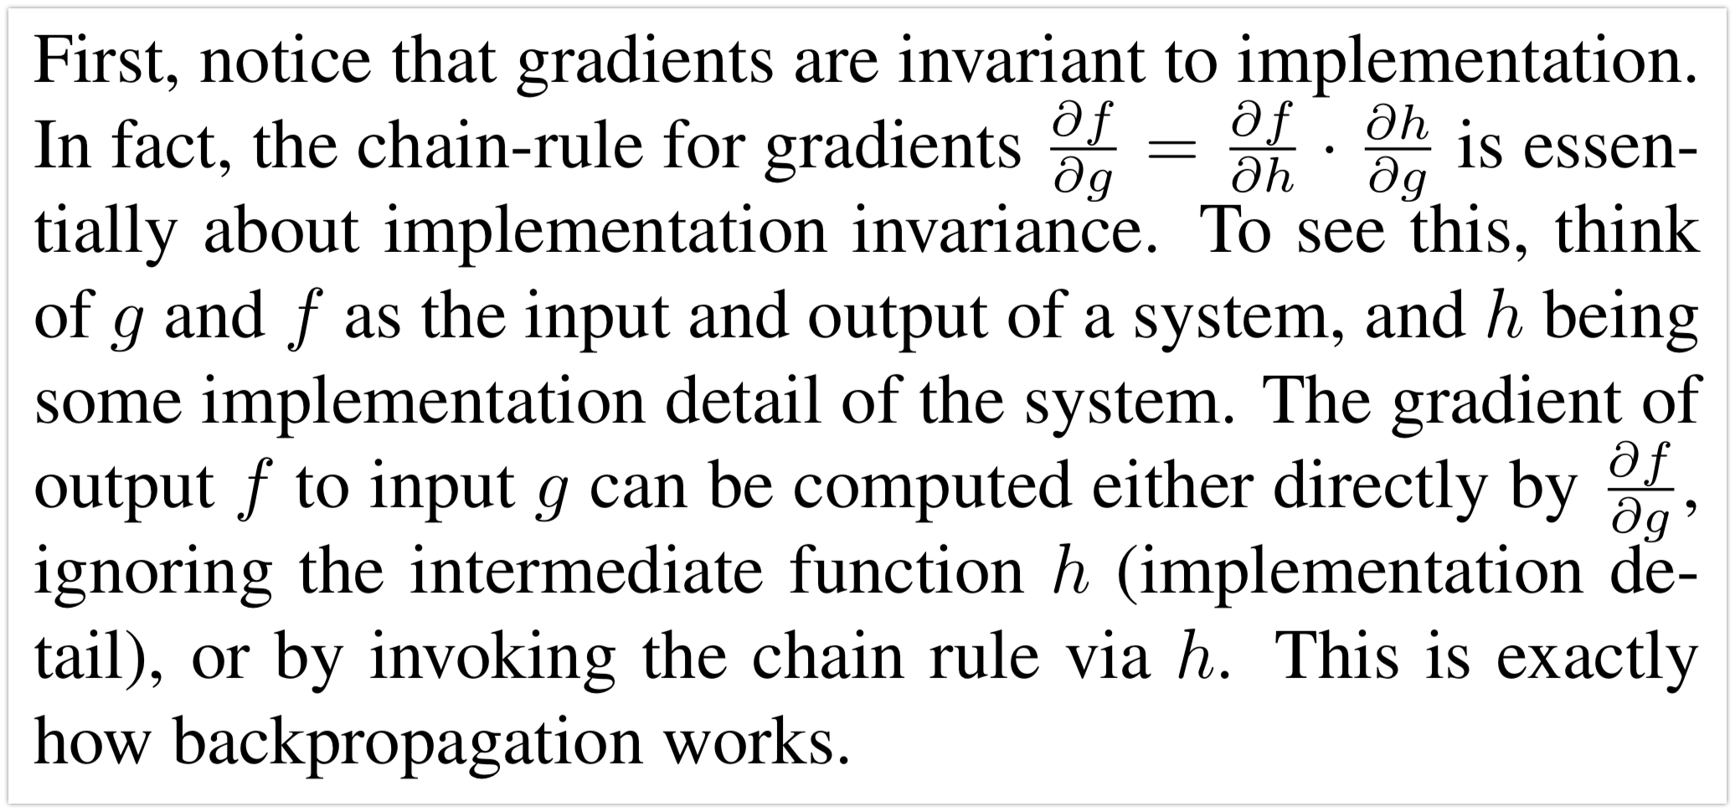
DeepLift and LRP violate Axiom 2

Slide 18
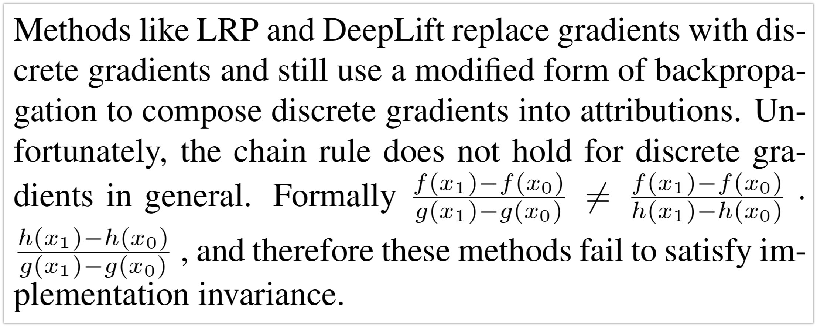
DeepLift and LRP violate Axiom 2

Slide 19
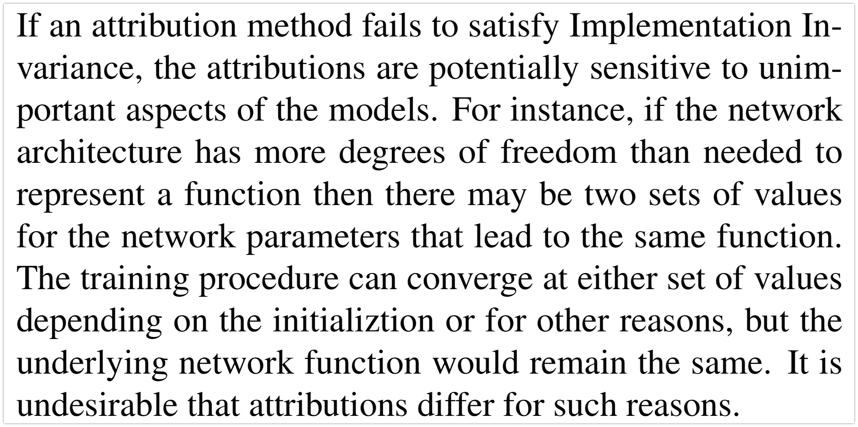
Violation of Axiom 2
Just nonidentifiability or overfitting?

Slide 20
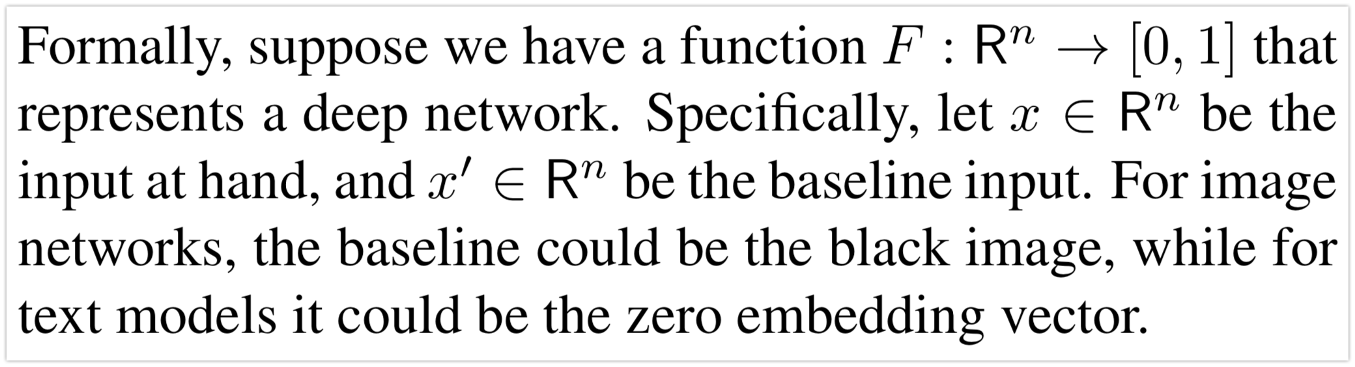
Our method: integrated gradients
Intuitively, our techniue combines the implementation invariance of Gradients along with the Sensitivity of tehniques like LRP or DeepLift.

Slide 21
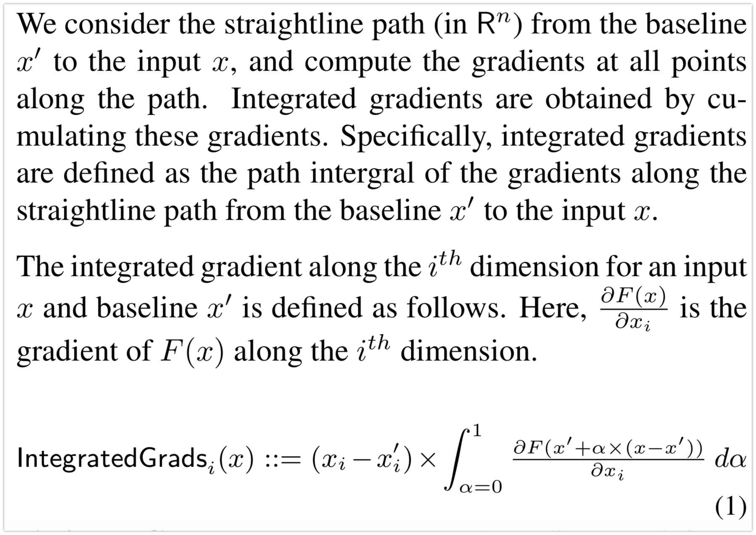
Our method: integrated gradients

Slide 22
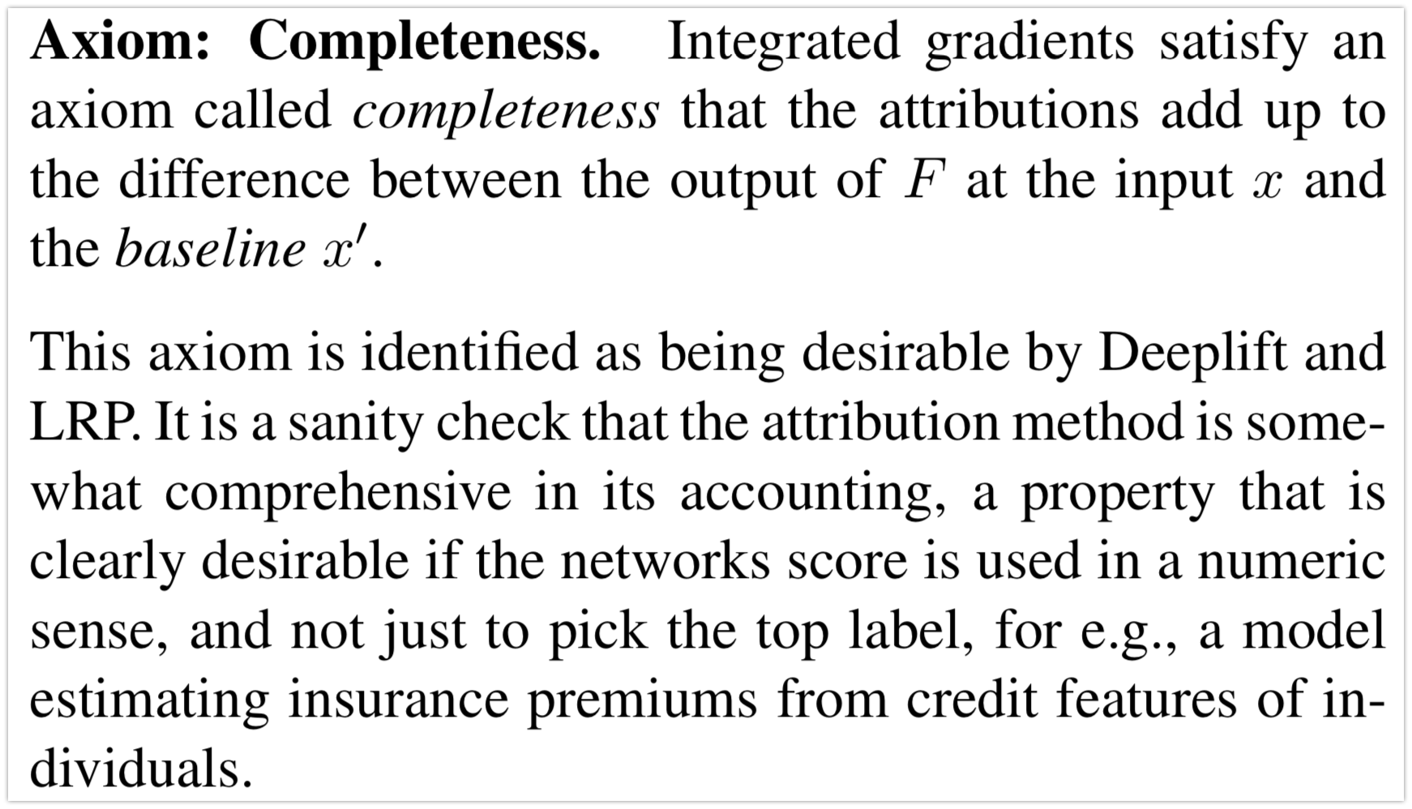
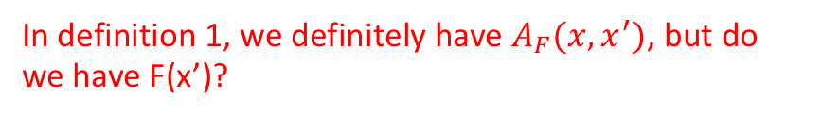
Integrated gradients satisfies Axiom 3
In definition 1, we definitely have $A_{F}(x,x^{′})$, but do we have F(x’)?

Slide 23
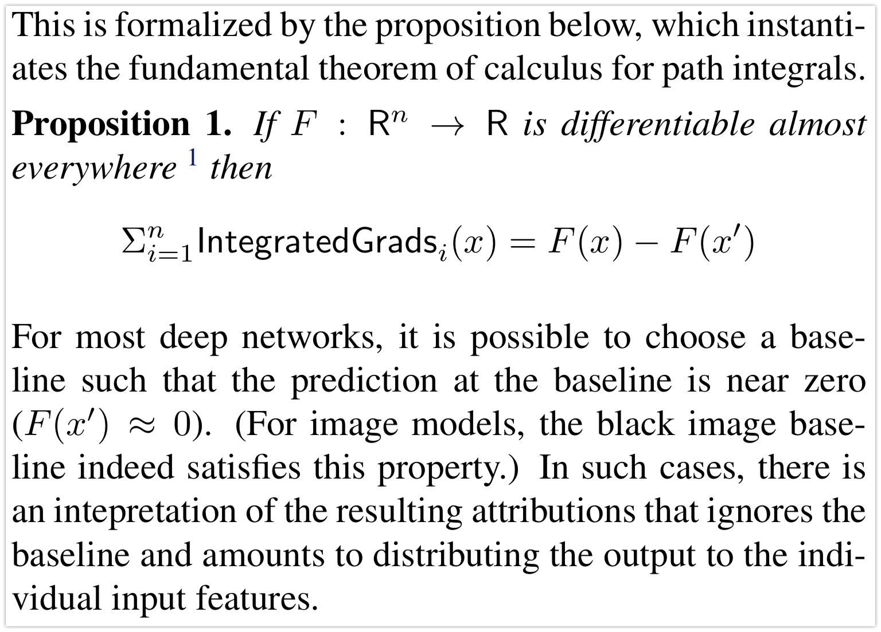
Integrated gradients satisfies Axiom 3

Slide 24
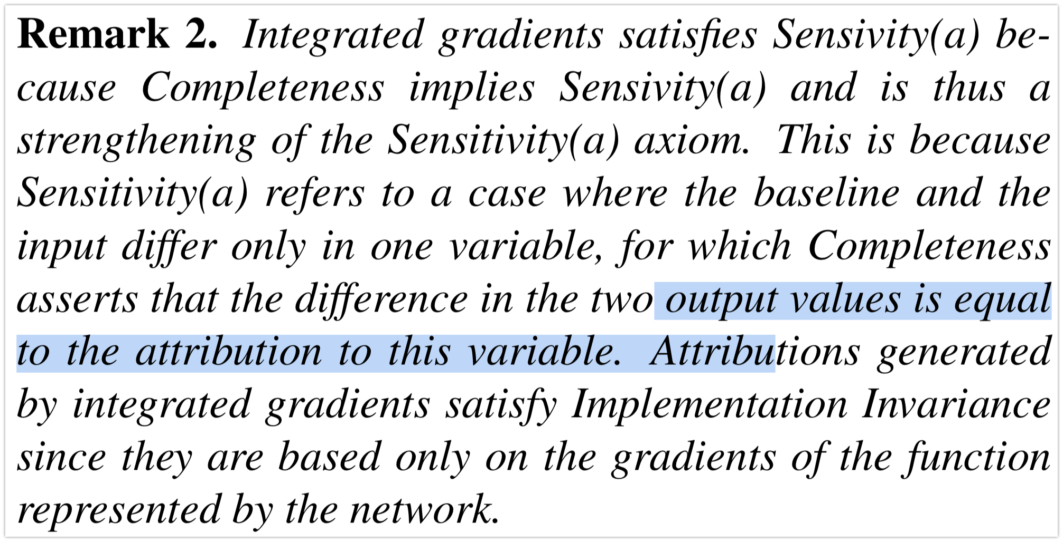
Integrated gradients satisfies Axiom 3 & axiom 1(a)

Slide 25
Recall sensitivity (a)
sensitivity (a) if for every input and baseline that differ in one feature but have different predictions then the differing feature should be given a non-zero attribution.

Slide 26
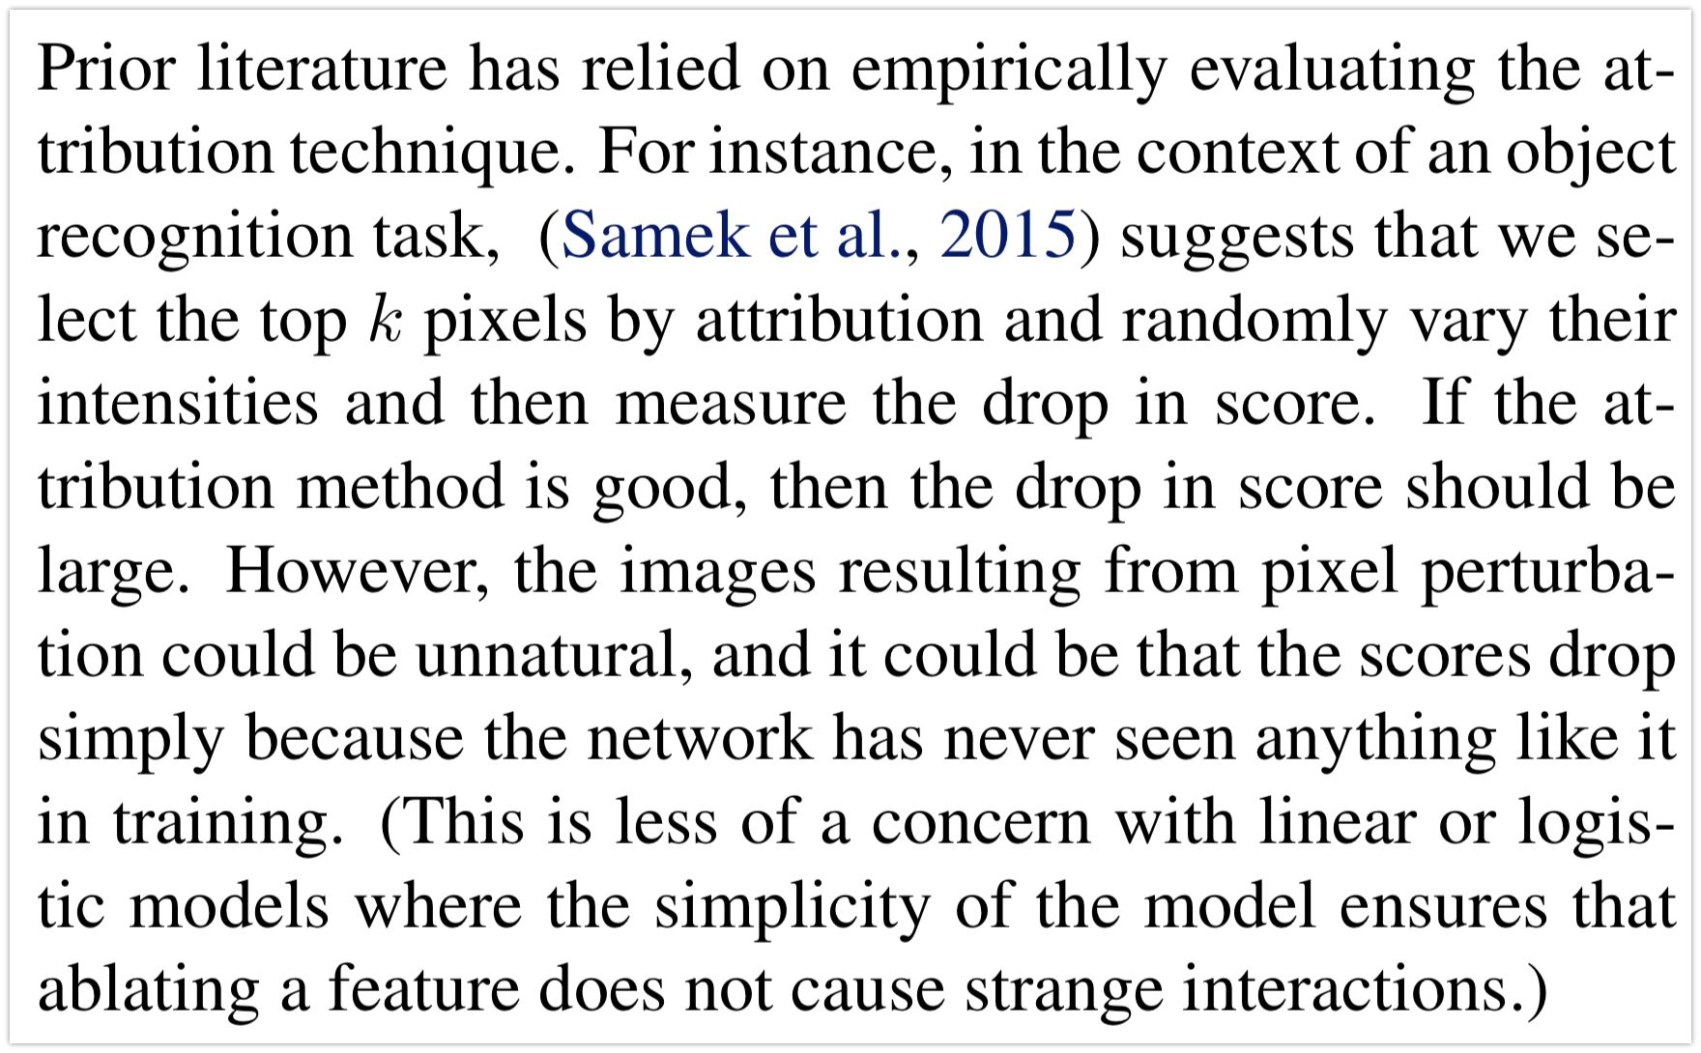
Uniqueness of Integrated Gradients
Not quite understand (for example, why “less of a concern with linear or logistic models”)

Slide 27
A different evaluation technique considers images with human-drawn bounding boxes around objects, and computes the percentage of pixel attribution inside the box. While for most objects, one would expect the pixels located on the object to be most important for the prediction, in some cases the context in which the object occurs may also contribute to the prediction. The cabbage butterfly image from Figure 2 is a good example of this where the pixels on the leaf are also surfaced by the integrated gradients.

Slide 28
Roughly, we found that every? empirical evaluation technique we could think of could not differentiate between artifacts that stem from
perturbing the data, a misbehaving model,? and
a misbehaving attribution method (maybe the method does not satisfy Axiom 1: sensitivity (a)).
This was why we turned to an axiomatic approach in designing a good attribution method (Section 2). While our method satisfies Sensitivity and Implementation Invariance (same explanation as chain rule for derivatives), it certainly isn’t the unique method to do so.

Slide 29
Uniqueness of Integrated gradients amongst Path methods
See the paper.
All path methods satisfy
implementation invariance.
Completeness => axiom 1 (a).
More interestingly, path methods are the only methods that satisfy Axiom 1(a), 2 (implementation invariance), 3 (completeness), Axiom 1(b), Axiom 4 (linearity).

Slide 30
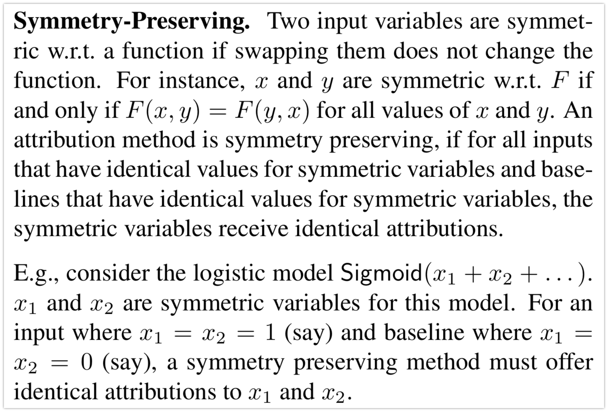
Uniqueness of Integrated gradients amongst Path methods
Theorem 1: Integrated gradients is symmetry preserving
From the proof, they are swapping x_i,x_j, however, I am unable to go through one part they talk about integrand.

Slide 31
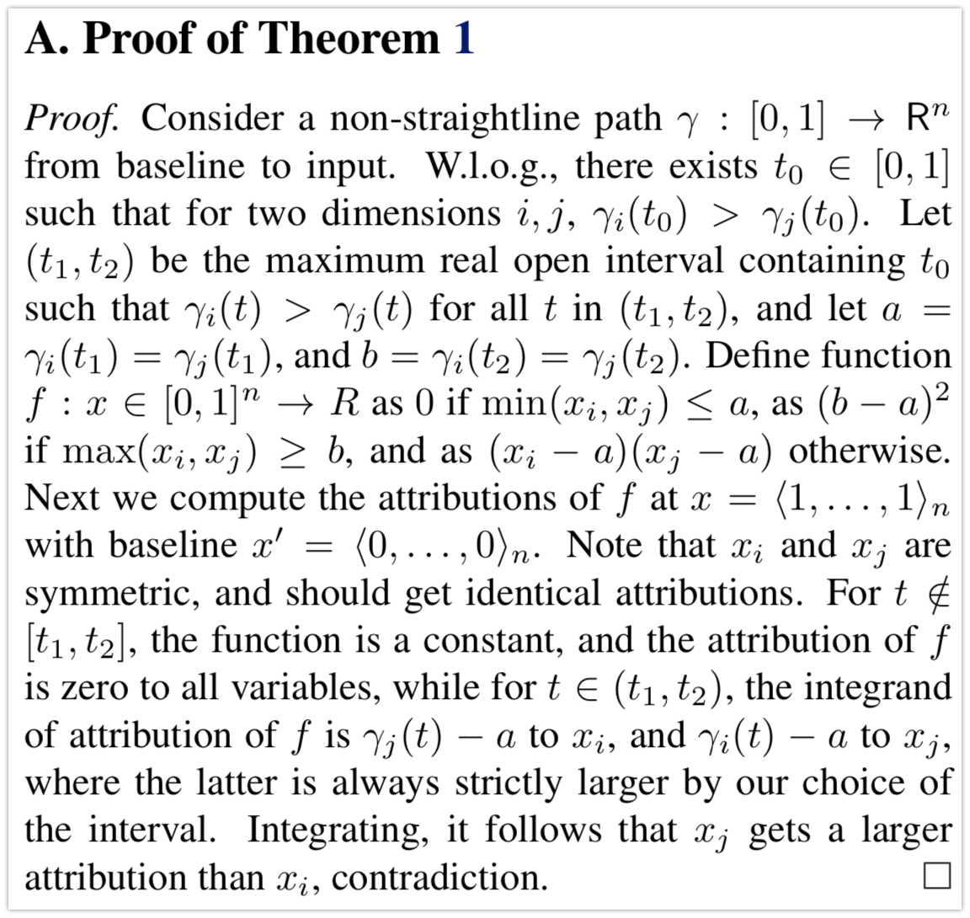
Theorem 1: Integrated gradients is symmetry preserving
Recall the definition of ”path methods”

Slide 32
Integrated gradients averaging over multiple paths?
See remark 5 (Shapley-Shubik). computationally expensive in deep networks

Slide 33
Applying integrated gradients
Selecting a benchmark:
A key step in applying integrated gradients is to select a good baseline. We recommend that developers check that the baseline has a near-zero score— as discussed in Section 3, this allows us to interpret the attributions as a function of the input. But there is more to a good baseline: For instance, for an object recognition net- work it is possible to create an adversarial example that has a zero score for a given input label (say elephant), by applying a tiny, carefully-designed perturbation to an image with a very different label (say microscope) (cf. (Goodfellow et al., 2015)). The attributions can then include undesirable artifacts of this adversarially constructed baseline. So we would additionally like the baseline to convey a complete absence of signal, so that the features that are apparent from the attributions are properties only of the input, and not of the baseline.

Slide 34
Applying integrated gradients
For instance, in an object recognition net- work, a black image signifies the absence of objects. The black image isn’t unique in this sense—an image consisting of noise has the same property. However, using black as a baseline may result in cleaner visualizations of “edge” fea- tures. For text based networks, we have found that the all- zero input embedding vector is a good baseline. The action of training causes unimportant words tend to have small norms, and so, in the limit, unimportance corresponds to the all-zero baseline. Notice that the black image corre- sponds to a valid input to an object recognition network, and is also intuitively what we humans would consider ab- sence of signal. In contrast, the all-zero input vector for a text network does not correspond to a valid input; it never- theless works for the mathematical reason described above.

Slide 35
Computing Integrated gradients: see paper
Applications:
Object recognition network (ORN): good they have improvement in their result
Diabetic Retinopathy Prediction
Question classification: (exactly what in my mind weeks ago) – attribution is more clear than ORN
Neural machine translation: attribution is more clear than ORN (not the probability matrix) however, it maps to [0,1]^n; sum of each = prediction score for each word
Chemistry models:column

